Slide 1
Binary

Slide 2
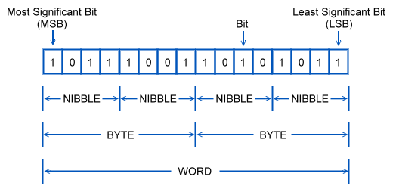
The Language of Computers
Computers are dumb - only know two symbols
Symbols are called “bits” (binary digits)
8 bits = 1 byte (most commonly)

Slide 3
Conversion Chart
Name | Size
Bit | Single Binary Digit (1 or 0)
Byte | 8 bits
Kilobyte | 1,024 bytes
Megabyte | 1,024 kilobytes
Gigabyte | 1,024 megabytes
Terabyte | 1,024 gigabytes
Petabyte | 1,024 terabytes

Slide 4
Reading Binary
Each bit in a byte represents a power of 2
Starting from 2⁰ at the right most bit, we increase the power by one when we move left
Powers of Two | 2⁷ | 2⁶ | 2⁵ | 2⁴ | 2³ | 2² | 2¹ | 2⁰
Actual Value | 128 | 64 | 32 | 16 | 8 | 4 | 2 | 1

Slide 5
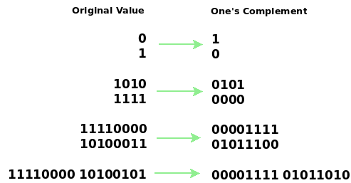
One’s Complement
Important for computations later on
The One’s Complement process is simple – just invert all the bits

Slide 6
Two’s Complement
We want negative values to be represented – but how?
The solution is to use Two’s Complement
The leftmost bit, or MSB (the Most Significant Bit) becomes the “sign bit”
0 is positive, 1 is negative

Slide 7
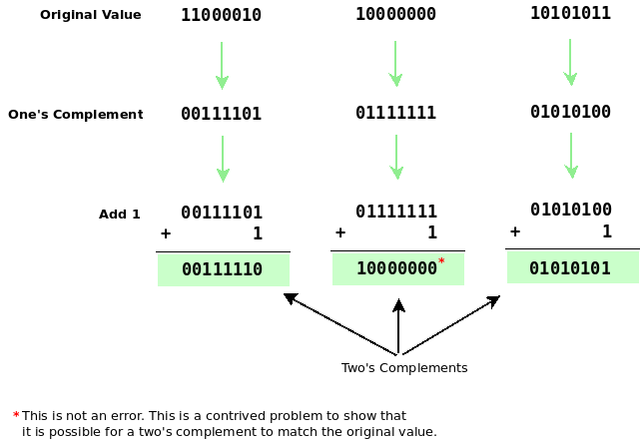
Two’s Complement Cont.
The Two’s Complement process is simple
First, find the One’s Complement (invert all bits)
Then add one
Profit!

Slide 8
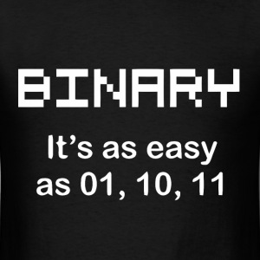
Questions?

